Slide 1
HNDIT1032 Computer and Network Systems
Week 10,11- Install OS & System Utilities

Slide 2
Introduction
OS controls and coordinates the use of hardware among the different application software and the users.
It provides an interface that is convenient for the user to use, and facilitates efficient operations of the computer system resources.

Slide 3
Operating System Installation
The installation and initial booting of the OS is called the operating system setup.
Although it is possible to install an OS over a network from a server or from a local hard drive, the most common installation method for a home or small business is with CDs or DVD.

Slide 4
Steps of OS Installation
Hard Disk Partitioning
Hard Disk Formatting
Default Setting
Date & Time Setting
Network Setting
Accounts Setting
Reboot the System

Slide 5
Hard Drive Partitioning
A hard drive is divided into specific areas called partitions.
Each partition is a logical storage unit that can be formatted to store information, such as data files and applications.
During the installation process, most operating systems automatically partition and format available hard drive space

Slide 6
Types of Partitions
Primary partition - This primary partition containing the operating system files is usually the first partition.
Active partition - Only one primary partition per disk can be marked active. In most cases, the C: drive is the active partition and contains the boot and system files.

Slide 7
Types of Partitions
Extended partition - The extended partition normally uses the remaining free space on a hard drive or takes the place of a primary partition

Slide 8
Hard Drive Formatting
A clean installation of an OS proceeds as if the disk were brand new. No information that is currently on the hard drive is preserved.
The first phase of the installation process partitions and formats the hard drive.
This process prepares the disk to accept the new file system.

Slide 9
File System
Windows operating systems use one of these file systems:
New Technology File System (NTFS)
File Allocation Table, 32 bit (FAT32)

Slide 10
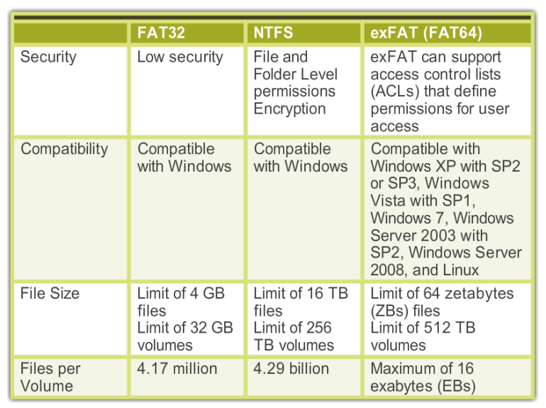
FAT vs NTFS

Slide 11
Quick vs Full Format
The quick format removes files from the partition, but does not scan the disk for bad sectors. Scanning a disk for bad sectors can prevent data loss in the future.
The full format removes files from the partition while scanning the disk for bad sectors. It is required for all new hard drives.

Slide 12
Installation with Default Setting
Install now-Sets up and installs the Windows
What to know before installing Windows - Opens a Help and Support window describing the Upgrade and Custom options for installing
Repair your computer - Opens the System Recovery Options utility to repair an installation.

Slide 13
Install Options
Language to install
Standards and formats that define currency and numerals
Keyboard or input method
Physical location of the installation
Username and computer name
Password for the administrative account
Product key
Time and date settings
Network setting

Slide 14
Network Setting
When configuring initial network settings during installation, you are prompted to select one of the following current locations
Home network
Work network
Public network

Slide 15
Account Creation
When users attempt to log in to a device or to access system resources, Windows uses the process of authentication to verify that the users are who they say they are.
Authentication occurs when users enter a username and password to access a user account.

Slide 16
Types of Accounts
A user with administrator privileges can make changes that impact all users of the computer, such as altering security settings or installing software for all users.
Standard Accounts- has fewer permissions than an administrator account
Guest Accounts-has limited permissions and must be turned on by an administrator

Slide 17
Complete the Installation
After the Windows installation copies all the necessary OS files to the hard drive, the computer reboots and prompts you to create a user account.
Microsoft Update Manager from the Start Menu to scan for new software, as well as install service packs and patches.

Slide 18
Device Manager
A device driver acts as a translator between the hardware and the software that uses the devices.
In other words, it intermediates between the device and the software, in order to use the device
Nowadays, the operating system comes preloaded with some commonly used device drivers, like the device driver for mouse, webcam, and keyboard.

Slide 19
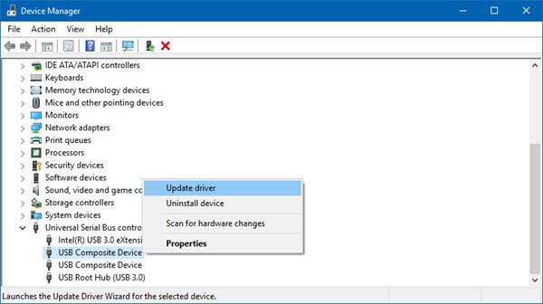
Example-Device Driver

Slide 20
Other Installation Methods
Network Installation
Preboot Execution Environment (PXE) Installation
Unattended Installation
Image-based Installation
Remote Installation

Slide 21
System Recovery
The System Recovery Options are a set of tools that allow users to recover or restore an operating system when it has failed.
The System Recovery Options are a part of the Windows Recovery Environment (WinRE). WinRE is a recovery platform based on the Windows Preinstallation Environment (PE).

Slide 22
System Image Recovery
It allows users to back up the contents of their hard drive, including personal files and settings, if an operating system needs to be restored

Slide 23
Windows Boot Process
When the computer is powered on, it performs a Power On Self Test (POST).
After POST, the BIOS locates and reads the configuration settings that are stored in the CMOS memory.
The boot device priority is set in the BIOS and can be arranged in any order.

Slide 24
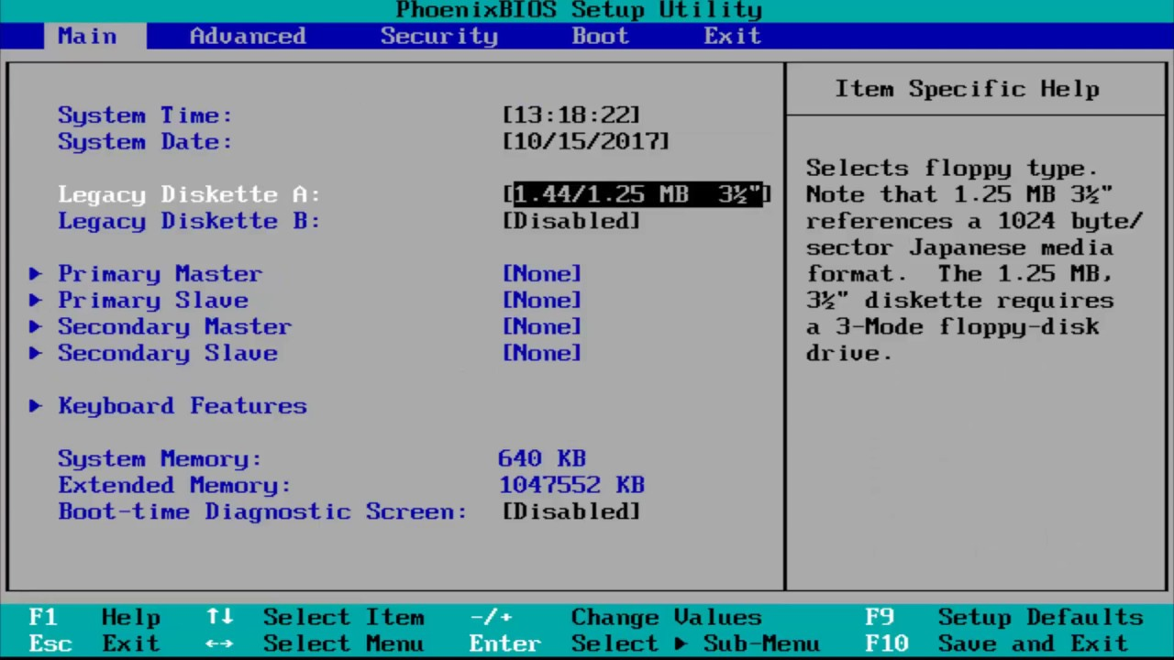
BIOS Setup Utility

Slide 25
Startup Modes
Safe Mode - Starts Windows but only loads drivers for basic components
Safe Mode with Networking-loads the drivers for network components.
Safe Mode with Command Prompt- loads the command prompt instead of the GUI
Last Known Good Configuration-configuration settings that were used the last time that Windows started successfully

Slide 26
Windows Registry
The Windows Registry keys are an important part of the Windows boot process.
These keys are recognized by their distinctive names, which begin with HKEY_, as shown in the figure, followed by the name of the portion of the OS under their control.
The Registry is also responsible for recording the location of Dynamic Link Library (DLL) files.

Slide 27
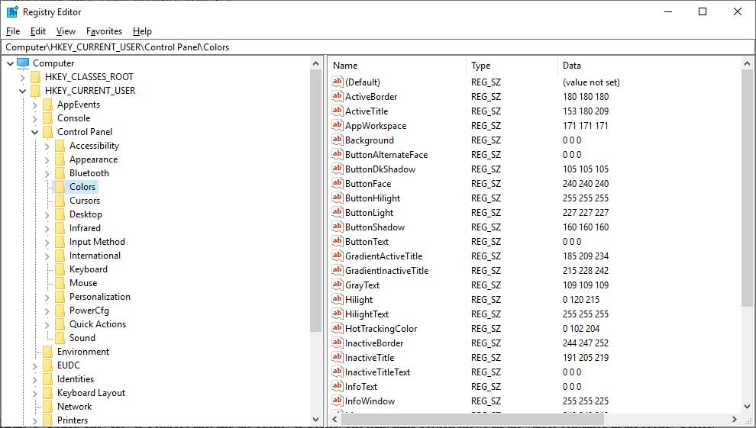
Example-Windows Registry

Slide 28
Multiboot
You can have multiple operating systems on a single computer.
There is a dual boot process for multiple operating systems on a computer.
During the boot process, if the Windows Boot Manager (BOOTMGR) determines that more than one OS is present, you are prompted to choose the OS.

Slide 29
System Utilities
Disk Management
File Management
Antivirus
Compression Tools
Disk Cleanup Tools
Disk Defragment Tools
Backup
Performance Monitoring Tools

Slide 30
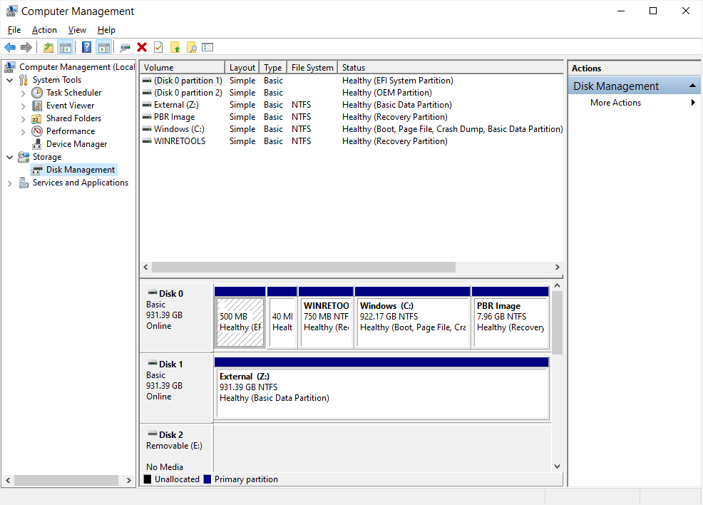
Disk Management
View drive status
Extend partitions
Split partitions
Assign drive letters
Add drives
Add array
Start > right-click Computer > Manage > select Disk Management

Slide 31
File Management
File Management Systems are the most basic of all types of software.
They are used to organize and store files on a computer, as well as index those files for easier retrieval.
Most computers come with a basic file management system that is built into the operating system.

Slide 32
Antivirus
Online threats are a serious problem. Viruses, malware, and hackers can ruin your computer and steal your data.
Antivirus software is used to prevent, detect and remove viruses from your computer.
A virus is a malicious piece of code that infects other files or computers for the purpose of replicating itself.

Slide 33
Example-Antivirus
Microsoft Defender
Norton 360 LifeLock
Bitdefender Antivirus
Eset
McAfee Total Protection
Quickheal Antivirus

Slide 34
Compression Tools
Compression tools are a set of computer programs that compress files. Compression is the process of taking data from a file and reducing its size of it
A compression tool reduces the file's size by removing blank spaces, repeating characters in a string, or combining two or more redundant files into one file - all without affecting the data in any way.

Slide 35
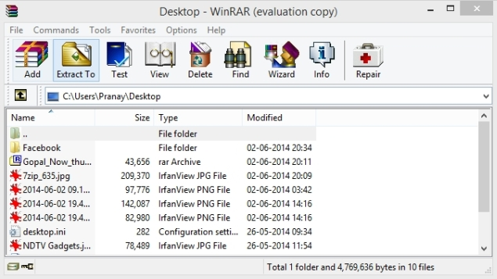
Example-Compression Tool
WinZip
WinRAR
7-Zip
Zip Archiver
PeaZip

Slide 36
Disk Cleanup Tool
Cleaning up your disk is one of the best ways to improve your computer’s performance.
Disk Cleanup Tool is a Microsoft utility that you can use to clean up all sorts of temporary files, including internet downloads, web browser cache, temporary Internet files, and much more.
The Disk Cleanup Tool lets you choose specific types of files to be deleted or removed.
You can also specify which hard drive to clean up or how much space to free up.

Slide 37
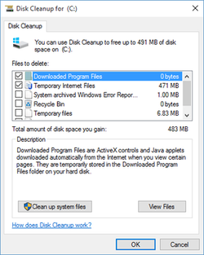
Example-Disk Cleanup Tools

Slide 38
Disk Defragment Tool
Disk defragmenters are utilities designed to rearrange data on a hard drive so that it is more evenly distributed and can be read from quicker.
It's important to use disk defragmenters periodically in order to keep the system running smoothly.

Slide 39
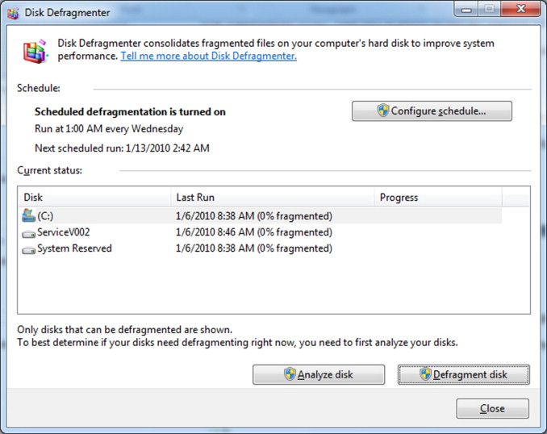
Example-Disk Defragment Tools

Slide 40
Backup & Restore
A backup utility is a software application that automatically backs up your data.
It can be external or internal hard drives, DVDs, CDs, and even online storage.
When it comes to backing up your data, you have two options: manual or automated.
Data restore is the process of copying backup data from secondary storage and restoring it to its original location or a new location.

Slide 41
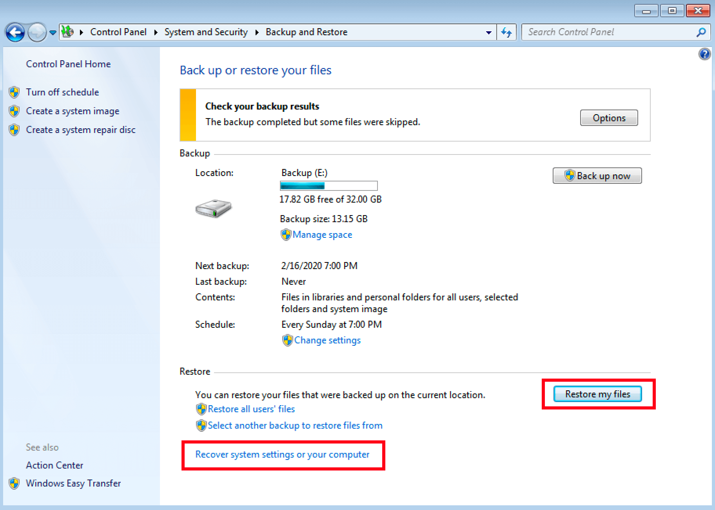
Example-Backup & Restore
Acronis True Image
Backblaze
Carbonite
EaseUS ToDo Backup
NovaBackup

Slide 42
Performance Monitoring Tools
Microsoft, Windows Performance Monitor uses configuration information, performance counters and event trace data to make a full examination of a computer's performance.
All of the information can be combined into Data Collector Sets.

Slide 43
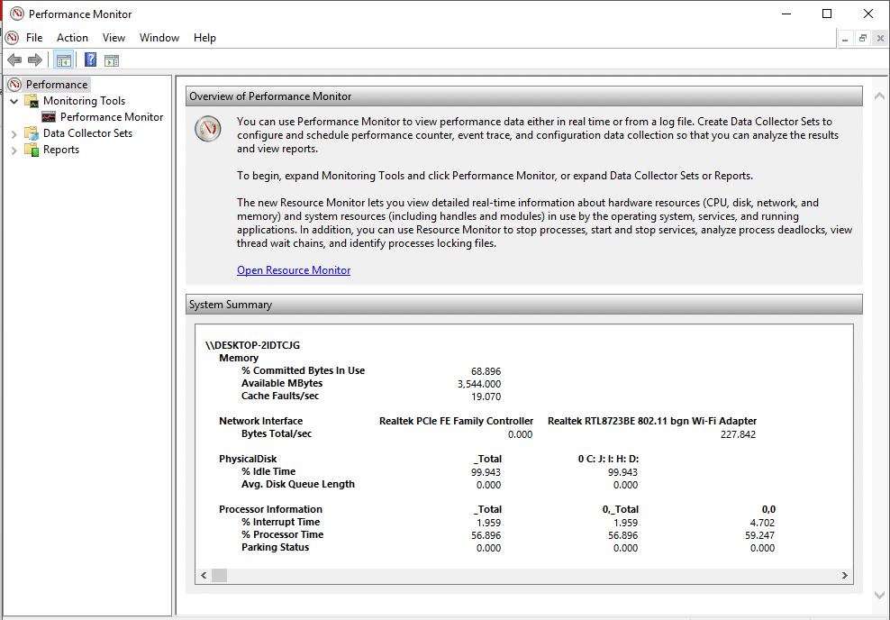
Example-Performance Monitor

Slide 44
Event Viewer
The Windows Event Viewer shows a log of application and system messages, including errors, information messages, and warnings.
It’s a useful tool for troubleshooting all kinds of different Windows problems.

Slide 45
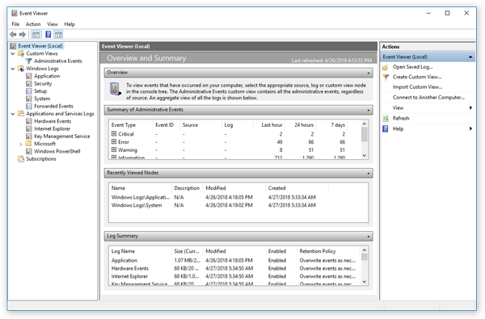
Example-Event Viewer

Slide 46
User File Location.
By default, Windows 7 and Windows Vista stores most of the files created by users in the folder C:\Users\User_name\. Windows XP uses the folder C:\Documents and Settings\User_name\
Each user’s folder contains folders for music, videos, websites, and pictures

Slide 47
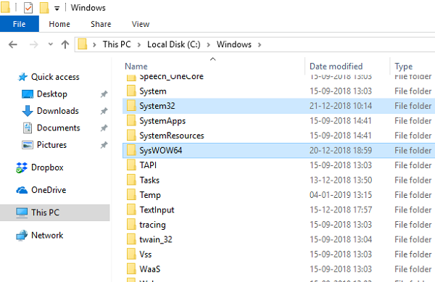
System File Location
When the Windows OS is installed, all files that are used to run the computer are located in the folder C:\Windows\system32.

Slide 48
File Extensions and Attributes
By default, file extensions are hidden. To display the file extensions you must disable the Hide extensions for known file types setting in the Folder Options control panel utility.
Start > Control Panel > Folder Options > View > uncheck

Slide 49
Example-File Extension
.docx - Microsoft Word (2007 and later)
.xlsx- Microsoft Excel
.txt - ASCII text only
.jpg - Graphics format
.pptx - Microsoft PowerPoint
.zip - Compression format

Slide 50
References
Clements, A., The Principles of Computer Hardware, Oxford University Press (4th Ed), 2006.

